Slide 1
JSC «TASHGIPROGOR»

Slide 2
COMPANY ESTABLISHMENT
1937 year is considered to be the year of institute’s birth, when in the system of Architectural-planning department out of the small group of specialists there was created the designing office Tashgorproject further named TASHGIPROGOR.
At the end of the thirties of the last century, by the small designing office comprising 40 specialists of the architectural-planning department there was developed the first Master plan of Tashkent city redevelopment, and in the 1938-39-es there was prepared a number of reconstruction projects of capital central streets.
In the middle of sixties of the last century, after the devastating earthquake, the designing company took part in the restoration works. The industrial construction base of Tashkent city developed the construction of multi-storey aseismic panel mass housing buildings per projects of 1-ТСП series elaborated by Institute “TASHGIPROGOR”.
Until now the team of the institute created a lot of unique constructions which obtained the public recognition. There were constructed various cultural and office buildings per projects of the Institute “TASHGIPROGOR”.
Now JSC “TASHGIPROGOR” has the solid reputation of well-organized, highly professional team. Working in close contact with foreign companies the institute gains the experience of designing taking into consideration the requirements of the international standards what improves the quality and production efficiency of design works.
JSC «TASHGIPROGOR» is situated in the capital of sovereign republic with more than 2 million population at the historical square Hadra.
The modern square “Hadra” is the large traffic centre, it’s the centre of public life – there are several ancient monuments, cultural and leisure facilities near “Hadra”.
Company’s shares are included to the category “C” of the listing of the Republican stock exchange “Toshkent” (index «TGPR»)

Slide 3
The main areas of specialization of JSC «TASHGIPROGOR»:
Development – of estimates, design and estimate documentation of the civil and industrial projects when implementing new construction, reconstruction and rebuilding;
Technical inspection of buildings and construction;
Designing of services:
electrical
plumbing
sewage
communication
gas
Stages of the project development for estimate documentation of civil and industrial projects:
Preliminary technical and economic calculation (ПТЕР)
Technical and economical calculation (ТЭР)
Working documentation (РД)
Design development (РП)
АО «TASHGIPROGOR» (personnel potential)
Managers | 15 people
Specialists | 148 people
Servants | 49 people
Workers | 43 people
Total: | 255 people

Slide 4
Company’s industrial structure:
Management (director, registry, spec.department, human recourses, accounting department, materials department, technical department)
Department №1 (management and 4 architectural and structural sectors)
Department №2 (management and 5 architectural and structural sectors))
Department №3 (management and 4 architectural and structural sectors))
Engineering department №1 (management and 13 groups)
Automation and designing department
Estimates department
Department for inspection and building reinforcement
Technical department
Projects issue department
Functional department
There are also another functional and subsidiary units in the company. The scope of all departments of designing company (functional, administrative and subsidiary) and interaction between them compose the organizational structure of the designing company.

Slide 5
Technology used
Software (AutoCAD, LIRA, Corel Draw, Photoshop, 3D Max, Microsoft OFFICE)
Estimates calculation (TN QURILISH)
Software (1C, Norma Hamkor)
PC equipment – 217 pcs
Special printing copying equipment – 4 pcs (REM)
Special equipment for drawings issue – 5 pcs (PLOTTERS)
All the necessary raw materials as well as components are available at local market in the unlimited quantities.
The requirements to the raw materials and components are standard and set as a rule in the instructions of the equipment used and technical means.

Slide 6
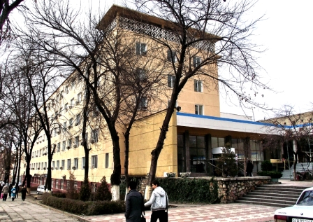
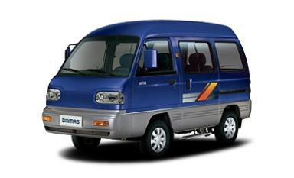
INFRASTRUCTURE OF JSC«TASHGIPROGOR»
Material and technical base
Company’s car park – 7 cars:
Chevrolet EPICA – 2 cars
Chevrolet DAMAS – 5 cars

Slide 7
Indicators of JSC«TASHGIPROGOR»

Slide 8
Financial plan of «TASHGIPROGOR»
Indicator | 2016 year | 2017 year | 2018 year | 2019 year | 2020 year
Amount of the executed works in current prices | 8 579 000 | 8 836 370 | 9 101 461 | 9 374 505 | 9 655 740
Net profit per business plan | 388 000 | 399 640 | 411 629 | 423 978 | 436 697
Growth rate to previous year | 103 | 103 | 103 | 103 | 103

Slide 9
Investment goal
State share stake sold to foreign investor is not less than 15% of the Charter fund of JSC «TASHGIPROGOR»
Estimated value of sold shares will be determined by Goskomkonkurentsii of the Republic of Uzbekistan
Attracted investment will be used: а) for renewal of the material and technical base of the company, including the total repair of buildings; б) for purchase of computers and other office equipment (scanners, plotters), as well as software development.

Slide 10
PROJECTS
Since gaining Independence in September 1,1991 JSC «TASHGIPROGOR» retains its status of the country’s largest developer of the designing estimates due to its reliability in execution of orders first of all in investment programs.
Being the General Designer of Tashkent the company performs up to 80% of designing product for the capital. At the same time it executes orders for other regions of the Republic of Uzbekistan as well as foreign countries such as Russia and Kazakhstan

Slide 11
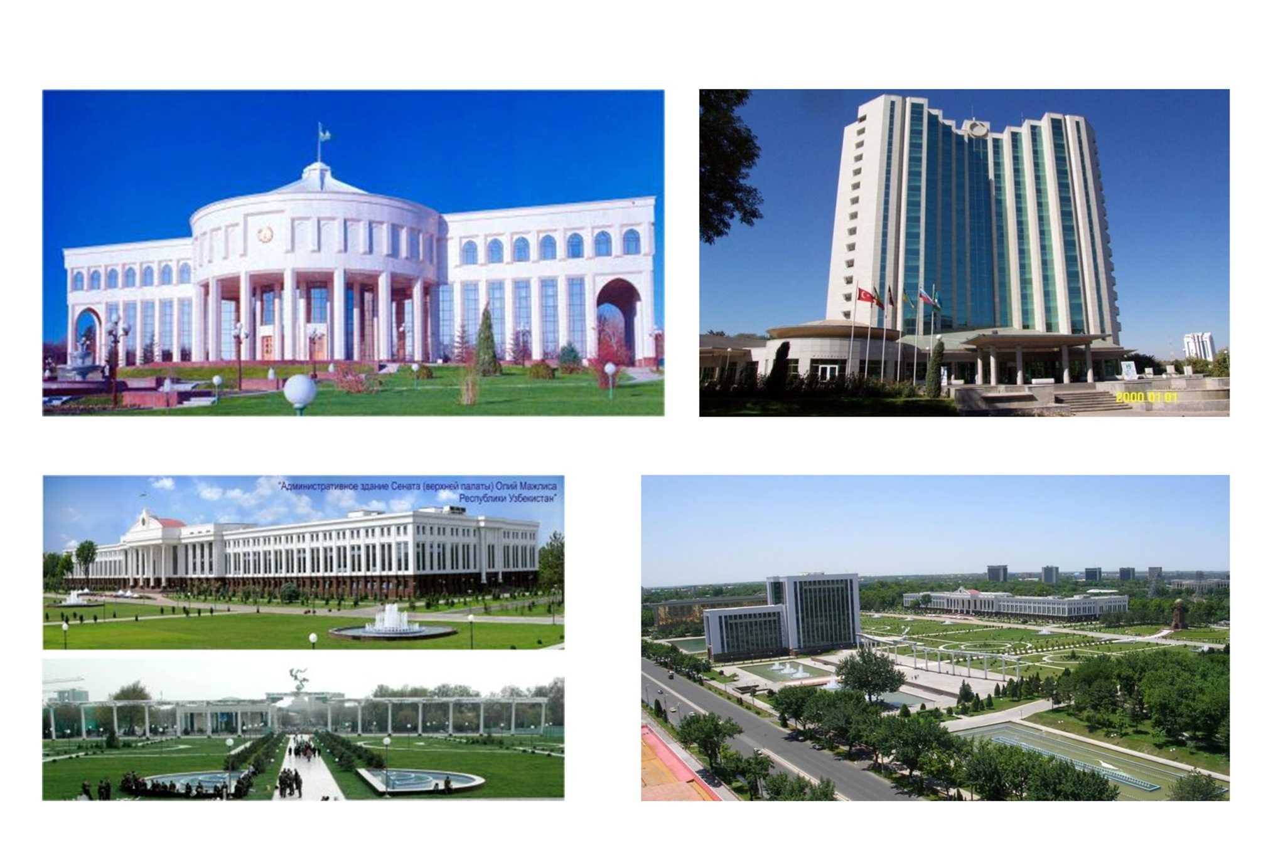

Slide 12
